Slide 1

Supporting Research with Data Management Plans and ReDATA
Roots for Resilience
Emily Davis

Slide 2
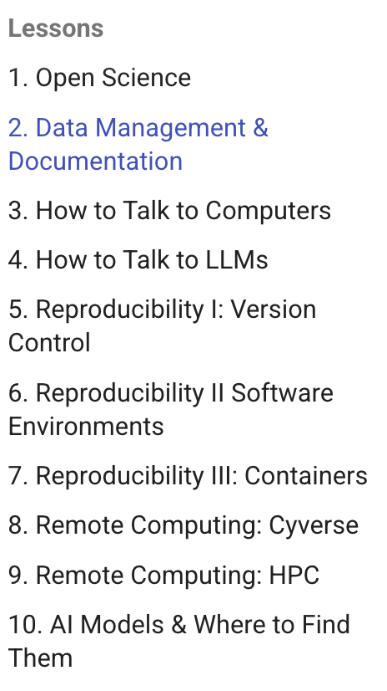
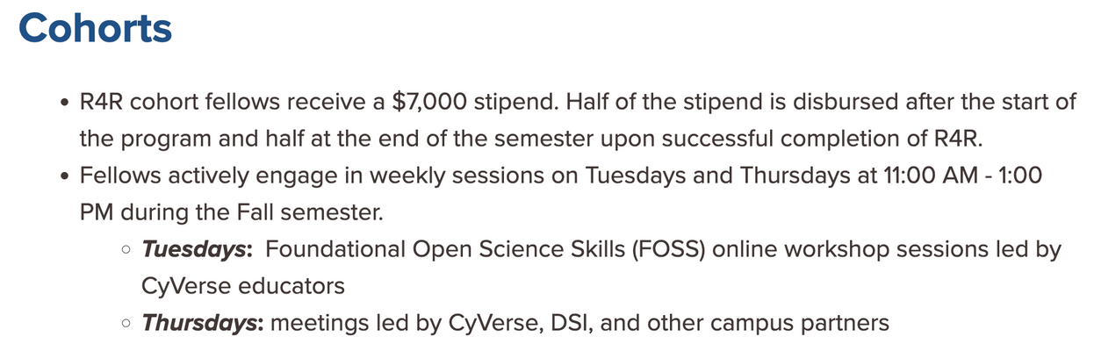



What is Roots for Resilience?

Slide 3
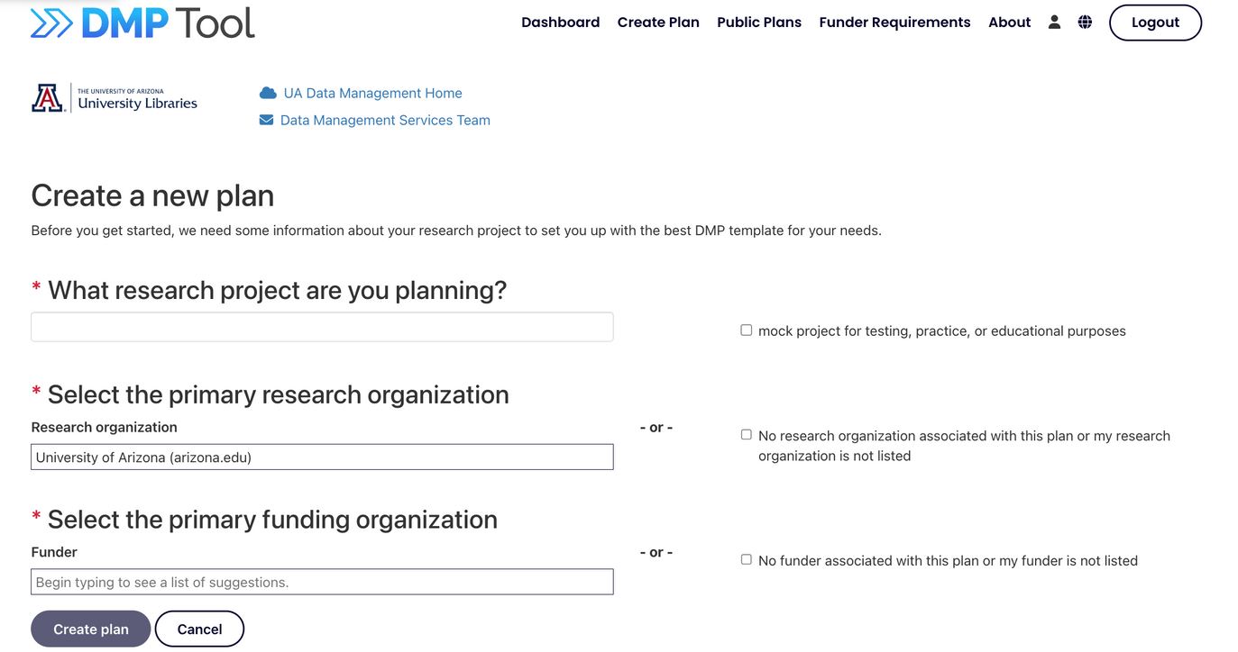
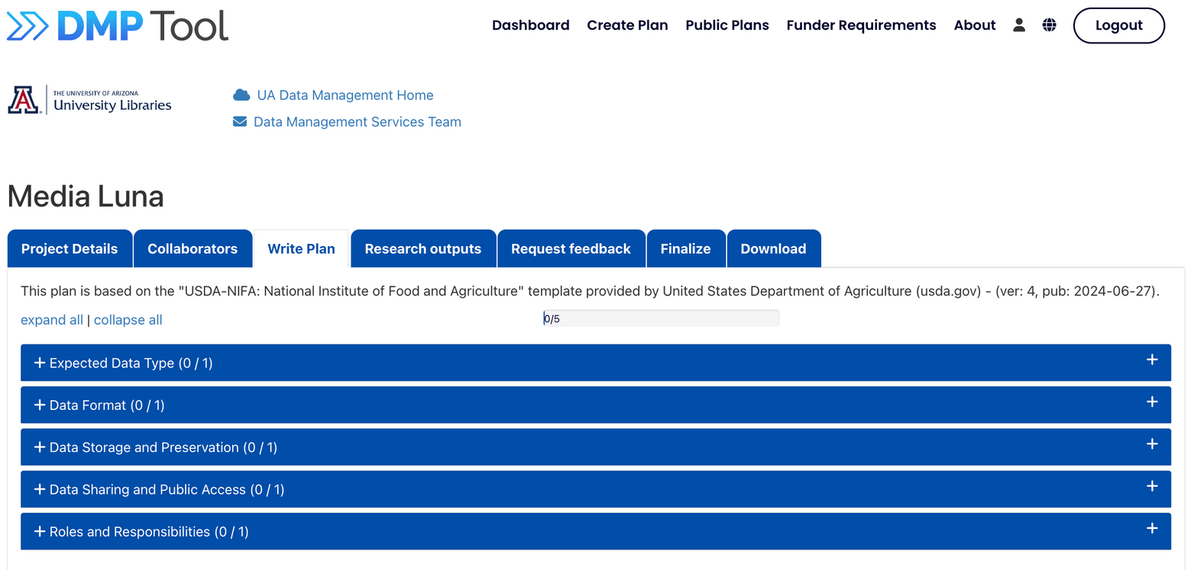
dmptool.org
https://data.library.arizona.edu/

Slide 4
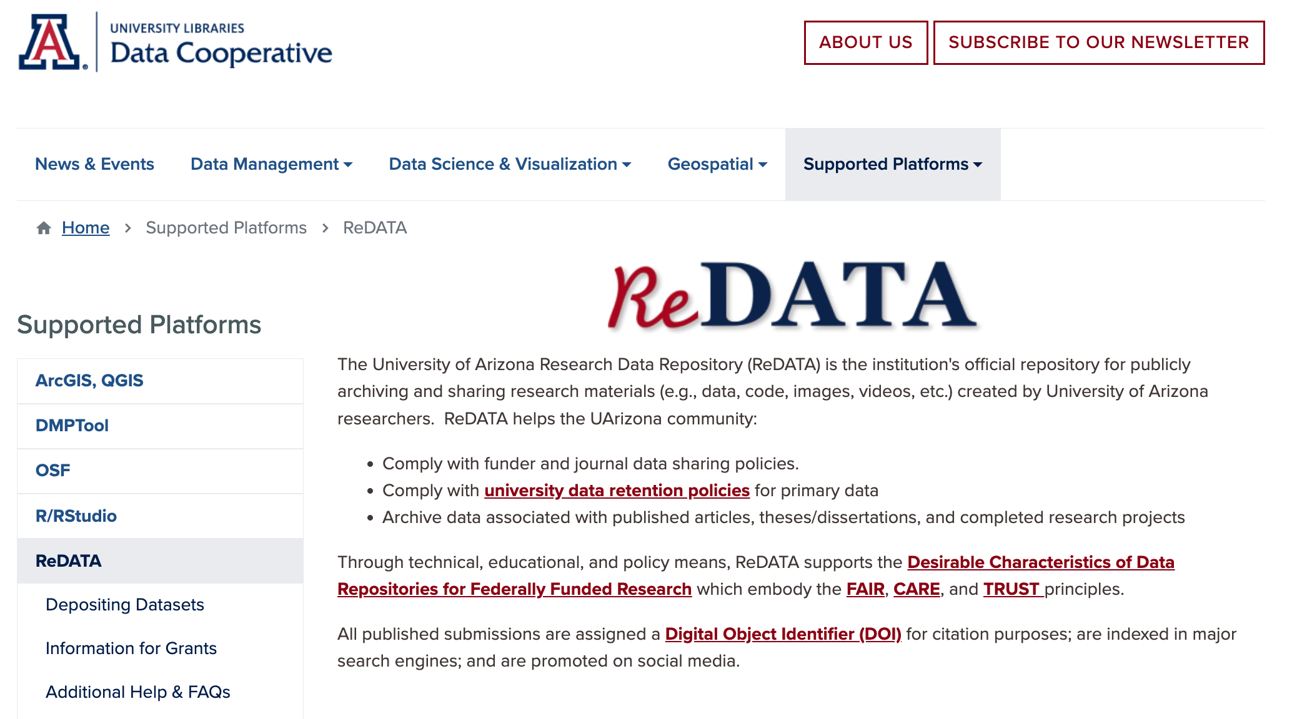

Slide 5
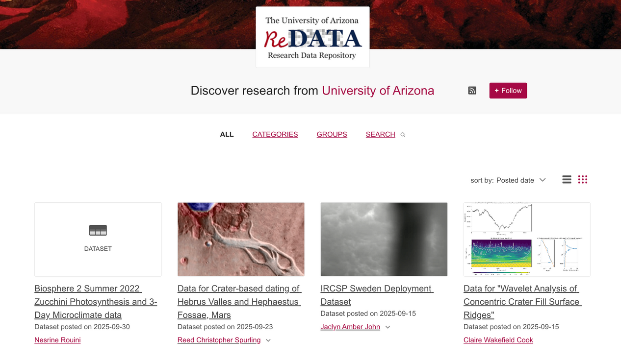
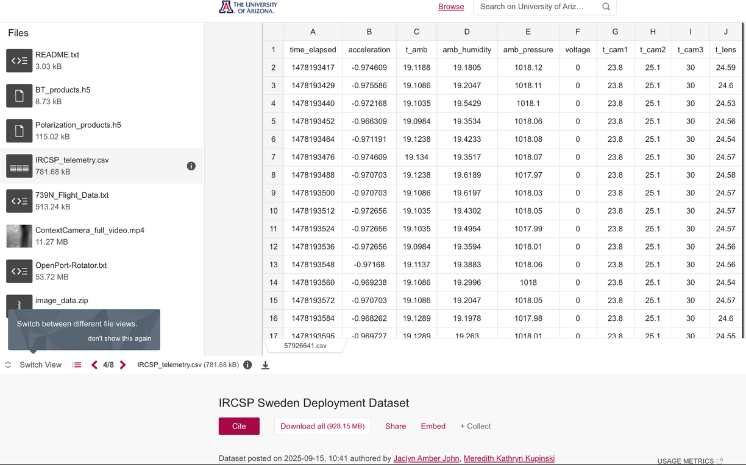
https://data.library.arizona.edu/supported-platforms/redata

Slide 6
More information about Roots for Resilience:
https://datascience.arizona.edu/r4r
Emily Davis
emilydavis@arizona.edu

